Slide 1
UNIT 1: Introduction to Operating System

Slide 2
Course Learning Objectives
1. To introduce the functions of an operating system, design, structure, and associated system calls
2. To study and analyze various scheduling algorithms and process synchronization techniques
3. To develop an understanding of deadlocks and deadlock recovery techniques.
4. To discuss and realize the importance of memory management techniques.
5. To gain knowledge of file systems and secondary storage structures.

Slide 3
Course Outcome (COs) At the end of the course, the student will be able to (Highlight the action verb representing the learning level.)
Learning Levels: Re - Remember; Un - Understand; Ap - Apply; An - Analysis; Ev - Evaluate; Cr - Create |  | Learning Level | PO(s) | PSO(s)
1. | Explain the computer system resources and the role of an operating system in managing those resources | Un | 1 | 1
2. | Develop applications keeping concurrency and synchronization, semaphores, Monitors, shared memory, mutual exclusion, process scheduling services of general operating system and do the case study on OSSim Simulation Tool. | Ap | 1,2,5 | 1
3. | Describe and analyze memory management, file management and secondary Memory Management techniques. | Ap | 2,5 | 1,2
4. | Discuss UNIX shell commands for file handling , process control and do the case study on on Android Operating System / iOS. | Un | 1,2 | 1,2
5 | Apply the learnings inculcated throughout the course and present a course seminar or develop a course project | An. | 1,2,3, 5,9,10,11,12 | 1,2,3

Slide 4
Program Outcome of this course (POs)
1.Engineering knowledge: Apply the knowledge of mathematics, science, engineering fundamentals, and an engineering specialization to the solution of complex engineering problems.
2.Problem analysis: Identify, formulate, review research literature, and analyze complex engineering problems reaching substantiated conclusions using first principles of mathematics, natural sciences, and engineering sciences.
PO- 1,2,3,5,9,10,11,12
Course Outcome (COs)

Slide 5
Unit – I | Contact Hours = 8 Hours
Introduction to Operating System: System structures: What operating systems do; Operating System operations; Process management; Memory management; Storage management; Protection and security; Distributed system; Operating System Services; System calls; Operating System structure; System boot. Introduction to UNIX File System: Inside UNIX, Internal and External Commands, Command structure. Case Study: Android Operating System / iOS

Slide 6
Unit 1: Introduction to Operating System
What Operating Systems Do 1.1
Operating-System Operations 1.5
Process Management 1.6
Memory Management 1.7
Storage Management 1.8
Protection and Security1.9
Distributed system; 1.10
Operating System Services; 2.1
System calls;2.3

Slide 7
Operating System structure;
System boot.
Introduction to UNIX File System: Inside UNIX, Internal and External Commands, Command structure.
Case Study: Android Operating System / iOS

Slide 8
What is an Operating System?
A program that acts as an intermediary between a user of a computer and the computer hardware
Operating system goals:
  Execute user programs and make solving user problems easier
  Make the computer system convenient to use
  Use the computer hardware in an efficient manner
A computer system can be divided roughly into four components: the hardware, the operating system, the application programs, and the users as shown in Figure below.

Slide 9

Four Components of a Computer System

Slide 10
Continued…
The hardware—the central processing unit (CPU), the memory, and the input/output (I/O) devices—provides the basic computing resources for the system.
The application programs—such as word processors, spreadsheets, compilers, and web browsers—define the ways in which these resources are used to solve users' computing problems.
The operating system controls and coordinates the use of the hardware among the various application programs for the various users.
operating systems from two viewpoints: User view
System view

Slide 11
What Operating Systems Do
Depends on the point of view
Users want convenience, ease of use and good performance.
  Don’t care about resource utilization.
But shared computer such as mainframe or minicomputer must keep all users happy.
Users of dedicate systems such as workstations have dedicated resources but frequently use shared resources from servers.
Handheld computers are resource poor, optimized for usability and battery life.
Some computers have little or no user interface, such as embedded computers in devices and automobiles.

Slide 12
Operating System Definition
OS is a resource allocator
  Manages all resources
  Decides between conflicting requests for efficient and fair resource use
OS is a control program
  Controls execution of programs to prevent errors and improper use of the computer

Slide 13
Operating System Definition (Cont.)
No universally accepted definition
“Everything a vendor ships when you order an operating system” is a good approximation
  But varies wildly
“The one program running at all times on the computer” is the kernel.
Everything else is either
  a system program (ships with the operating system) , or
  an application program.

Slide 14
Operating-System Operations (cont.)
Dual-mode operation allows OS to protect itself and other system components
  User mode and kernel mode
  Mode bit provided by hardware
    Provides ability to distinguish when system is running user code or kernel code
    Some instructions designated as privileged, only executable in kernel mode
    System call changes mode to kernel, return from call resets it to user
Increasingly CPUs support multi-mode operations
  i.e. Virtual Machine Manager (VMM) mode for guest VMs

Slide 15

Transition from User to Kernel Mode
Timer to prevent infinite loop / process hogging resources
  Timer is set to interrupt the computer after some time period
  Keep a counter that is decremented by the physical clock.
  Operating system set the counter (privileged instruction)
  When counter zero generate an interrupt
  Set up before scheduling process to regain control or terminate program that exceeds allotted time

Slide 16
Process Management
A process is a program in execution. It is a unit of work within the system. Program is a passive entity, process is an active entity.
Process needs resources to accomplish its task
  CPU, memory, I/O, files
  Initialization data
Process termination requires reclaim of any reusable resources
Single-threaded process has one program counter specifying location of next instruction to execute
  Process executes instructions sequentially, one at a time, until completion
Multi-threaded process has one program counter per thread
Typically system has many processes, some user, some operating system running concurrently on one or more CPUs
  Concurrency by multiplexing the CPUs among the processes / threads

Slide 17
Process Management Activities
The operating system is responsible for the following activities in connection with process management:
Creating and deleting both user and system processes
Suspending and resuming processes
Providing mechanisms for process synchronization
Providing mechanisms for process communication
Providing mechanisms for deadlock handling

Slide 18
Memory Management
To execute a program all (or part) of the instructions must be in memory
All (or part) of the data that is needed by the program must be in memory.
Memory management determines what is in memory and when
  Optimizing CPU utilization and computer response to users
Memory management activities
  Keeping track of which parts of memory are currently being used and by whom
  Deciding which processes (or parts thereof) and data to move into and out of memory
  Allocating and deallocating memory space as needed

Slide 19
Mass-Storage Management
Usually disks used to store data that does not fit in main memory or data that must be kept for a “long” period of time
Proper management is of central importance
Entire speed of computer operation hinges on disk subsystem and its algorithms
OS activities
  Free-space management
  Storage allocation
  Disk scheduling
Some storage need not be fast
  Tertiary storage includes optical storage, magnetic tape
  Still must be managed – by OS or applications
  Varies between WORM (write-once, read-many-times) and RW (read-write)

Slide 20

Performance of Various Levels of Storage
Movement between levels of storage hierarchy can be explicit or implicit

Slide 21
Protection and Security
Protection – any mechanism for controlling access of processes or users to resources defined by the OS
Security – defense of the system against internal and external attacks
  Huge range, including denial-of-service, worms, viruses, identity theft, theft of service
Systems generally first distinguish among users, to determine who can do what
  User identities (user IDs, security IDs) include name and associated number, one per user
  User ID then associated with all files, processes of that user to determine access control
  Group identifier (group ID) allows set of users to be defined and controls managed, then also associated with each process, file
  Privilege escalation allows user to change to effective ID with more rights

Slide 22
Distributed Systems
A distributed system is a collection of physically separate, possibly heterogeneous computer systems that are networked to provide the users with access to the various resources that the system maintains. Access to a shared resource increases computation speed, functionality, data availability, and reliability.
A network, in the simplest terms, is a communication path between two or more systems. Distributed systems depend on networking for their functionality. Networks.
Networks are characterized based on the distances between their nodes.
A local-area network (LAN) connects computers within a room, a floor, or a building.
A wide-area network (WAN) usually links buildings, cities, or countries.
metropolitan-area network (MAN) could link buildings within a city.
A network operating system is an operating system that provides features such as file sharing across the network and that includes a communication scheme that allows different processes on different computers to exchange messages.

Slide 23

A View of Operating System Services

Slide 24
Functions provided by O.S
Following are functions provided by operating-system that are helpful to the user.
User interface : Almost all operating systems have a user interface (UI).
Command-line interface (CLI), which uses text commands and a method for entering them (say, a program to allow entering and editing of commands).
Batch interface, in which commands and directives to control those commands are entered into files, and those files are executed.
Most commonly a graphical user interface (GUI) is used. Here, the interface is a window system with a pointing device to direct I/O, choose from menus, and make selections and a keyboard to enter text. Some systems provide two or all three of these variations.

Slide 25
Operating System Services
Operating systems provide an environment for execution of programs and services to programs and users
One set of operating-system services provides functions that are helpful to the user:
  User interface - Almost all operating systems have a user interface (UI).
    Varies between Command-Line (CLI), Graphics User Interface (GUI), Batch
  Program execution - The system must be able to load a program into memory and to run that program, end execution, either normally or abnormally (indicating error)
  I/O operations - A running program may require I/O, which may involve a file or an I/O device

Slide 26
Operating System Services (Cont.)
One set of operating-system services provides functions that are helpful to the user (Cont.):
  File-system manipulation - The file system is of particular interest. Programs need to read and write files and directories, create and delete them, search them, list file Information, permission management.
  Communications – Processes may exchange information, on the same computer or between computers over a network
    Communications may be via shared memory or through message passing (packets moved by the OS)
  Error detection – OS needs to be constantly aware of possible errors
    May occur in the CPU and memory hardware, in I/O devices, in user program
    For each type of error, OS should take the appropriate action to ensure correct and consistent computing
    Debugging facilities can greatly enhance the user’s and programmer’s abilities to efficiently use the system

Slide 27
Operating System Services (Cont.)
Another set of OS functions exists for ensuring the efficient operation of the system itself via resource sharing
  Resource allocation - When multiple users or multiple jobs running concurrently, resources must be allocated to each of them
    Many types of resources - CPU cycles, main memory, file storage, I/O devices.
  Accounting - To keep track of which users use how much and what kinds of computer resources
  Protection and security - The owners of information stored in a multiuser or networked computer system may want to control use of that information, concurrent processes should not interfere with each other
    Protection involves ensuring that all access to system resources is controlled
    Security of the system from outsiders requires user authentication, extends to defending external I/O devices from invalid access attempts

Slide 28
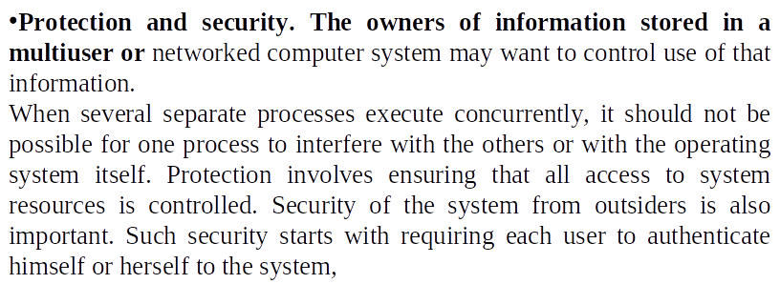

Slide 29
System Calls
System calls provide an interface to the services made available by an operating system.
Typically written in a high-level language (C or C++)
Mostly accessed by programs via a high-level Application Programming Interface (API) rather than direct system call use
Three most common APIs are Win32 API for Windows, POSIX API for POSIX-based systems (including virtually all versions of UNIX, Linux, and Mac OS X), and Java API for the Java virtual machine (JVM)

Slide 30
System Calls
How system calls are used ?
Example : Writing a simple program to read data from one file and copy them to another file.
The first input that the program will need is the names of the two files: the input file and the output file. These names can be specified in many ways, depending on the operating-system design.
One approach is for the program to ask the user for the names of the two files.
In an interactive system, this approach will require a sequence of system calls, first to write a prompting message on the screen and then to read from the keyboard the characters that define the two files.
On mouse-based and icon-based systems, a menu of file names is usually displayed in a window. The user can then use the mouse to select the source name, and a window can be opened for the destination name to be specified.
This sequence requires many I/O system calls !

Slide 31

Example of System Calls
System call sequence to copy the contents of one file to another file

Slide 32
System Call Implementation
Typically, a number is associated with each system call
  System-call interface maintains a table indexed according to these numbers
The system call interface invokes the intended system call in OS kernel and returns status of the system call and any return values
The caller need know nothing about how the system call is implemented
  Just needs to obey API and understand what OS will do as a result call
  Most details of OS interface hidden from programmer by API
    Managed by run-time support library (set of functions built into libraries included with compiler)

Slide 33

API – System Call – OS Relationship
Relationship between API, the system call interface and the operating system is shown in below figure.
Notes:
Relationship between API, the system call interface and the operating system is shown in below figure.

Slide 34
System Call Parameter Passing
Three general methods used to pass parameters to the OS
  Simplest: pass the parameters in registers
    In some cases, may be more parameters than registers
  Parameters stored in a block, or table, in memory, and address of block passed as a parameter in a register
    This approach taken by Linux and Solaris
  Parameters placed, or pushed, onto the stack by the program and popped off the stack by the operating system
  *Block and stack methods do not limit the number or length of parameters being passed

Slide 35

Parameter Passing via Table
Parameters stored in a block, or table, in memory, and address of block passed as a parameter in a register

Slide 36
Operating System Structure
General-purpose OS is very large program
Various ways to structure ones
  Simple structure – MS-DOS
  More complex -- UNIX
  Layered – an abstraction
  Microkernel –Mach
  Modules

Slide 37

Simple Structure -- MS-DOS
The system was simple , small and limited system and grew beyond their original scope later. Ex MS-DOS
MS-DOS – written to provide the most functionality in the least space ,so it was
  Not divided into modules
  No dual mode
  No h/w protection.
Notes:
Another example of limited structuring was original UNIX OS.

Slide 38

Traditional UNIX System Structure
Another example of limited structuring was original UNIX OS.
Beyond simple but not fully layered

Slide 39

Layered Approach
The operating system is divided into a N number of layers (levels), each built on top of lower layers.
The bottom layer (layer 0), is the hardware; the highest (layer N) is the user interface.
With modularity, layers are selected such that each uses functions (operations) and services of only lower-level layers
Notes:
Advantage of layered approach is simplicity of construction and debugging.

Slide 40
Advantages:
Advantage of layered approach is simplicity of construction and debugging.
It simplifies debugging and system verification. i.e first layer can be debugged without any concern for the
Dis-Advantages:
The difficulty in layered approach is proper defining the various layers.
They tend to be less efficient than other types.
of the system and so on.
Notes:
Advantages:
Simplicity of construction and debugging.
It simplifies debugging and system verification. i.e first layer can be debugged without any concern for the rest of the system and so on.

Slide 41
Microkernel System Structure
The kernel became large and difficult to manage,
Researcher at Carnegie Mellon university developed an OS called Mach Kernel using microkernel approach.
This method structures the OS by removing all non essentials components from the kernel and implementing them as system and user level programs. Therefore it results in smaller level kernel.
Mach example of microkernel
  Mac OS X kernel (Darwin) partly based on Mach
Main function of micro kernel is to provide communication between the client program and various services in user space.
Communication takes place between user modules using message passing

Slide 42
Benefits:
  Easier to extend a microkernel
  Easier to port the operating system to new architectures
  More reliable (less code is running in kernel mode)
  More secure
Detriments:
  Performance overhead of user space to kernel space communication

Slide 43

Microkernel System Structure

Slide 44
Modules
Many modern operating systems implement loadable kernel modules
The kernel has a set of core components and links in additional service.
  Uses object-oriented approach
  Each core component is separate
  Each talks to the others over known interfaces
  Each is loadable as needed within the kernel
Overall, similar to layers but with more flexible
  Linux, Solaris, etc

Slide 45

Solaris Modular Approach
Ex: Solaris OS structure has seven types of loadable kernel modules.
It is more similar like microkernels , but it is more efficient because modules need not invoke message passing in order to communicate.
Notes:
It is more similar like microkernels .It is more efficient because modules need not invoke message passing in order to communicate.

Slide 46
System Boot
When power initialized on system, execution starts at a fixed memory location
  Firmware ROM used to hold initial boot code
Operating system must be made available to hardware so hardware can start it
  Small piece of code – bootstrap loader, stored in ROM(read only memory) or EEPROM locates the kernel, loads it into memory, and starts it
  Sometimes two-step process where boot block at fixed location loaded by ROM code, which loads bootstrap loader from disk
Common bootstrap loader, GRUB, allows selection of kernel from multiple disks, versions, kernel options
Kernel loads and system is then running

Slide 47
Introduction to UNIX
Introduction to UNIX File System: Inside UNIX, Internal and External Commands, Command structure.

Slide 48
What is UNIX?
A set of programs that act as a link between the computer and the user.
The computer programs that allocate the system resources and coordinate all the details of the computer's internals is called the operating system or the kernel.
Users communicate with the kernel through a program known as the shell.
The shell is a command line interpreter; it translates commands entered by the user and converts them into a language that is understood by the kernel.
What is UNIX?

Slide 49
Unix was originally developed in 1969 byAT&T employees Ken Thompson, Dennis Ritchie, Douglas McIlroy, and Joe Ossanna at Bell Labs.
There are various Unix variants available in the market. Solaris Unix, AIX, HP Unix and BSD are a few examples. Linux is also a flavor of Unix which is freely available.
Several people can use a Unix computer at the same time; hence multiuser system.
User can run multiple programs at the same time; hence multitasking environment.

Slide 50
UNIX Features
UNIX also looks at a few things in a different way than other OS. Features of UNIX :
1. Multiuser System :
Unix provides multiple programs to run and compete for the attention of the CPU. This happens in 2 ways :
Multiple users running multiple jobs
Single user running multiple jobs
Resources are shared between all the users, multi-user system. Computer gives a time slice (breaking unit of time into several segments ) to each user. So, at any instant of time, only one user is served but the switching is so fast that it gives an illusion that all the users are served at same time.
2. Multitask System :
A single user may run multiple tasks concurrently. Example : Editing a file, printing another on the printer & sending email to a person, and browsing the net too at the same time. Designed to handle user’s multiple needs.
Only one job can be seen running in the foreground, the rest all seems to run in the background. Users can switch between them, terminate/suspend any of the jobs.

Slide 51
3. The Building-Block Approach : (Do one thing well)
Unix has so many commands, each of which performs one simple job only. One can use 2 commands by using pipes (‘|’).
Example : $ ls | wc Here, | (pipe) connects 2 commands to create a pipeline. This command counts the number of files in the directory. These types of connected commands that can filter/manipulate data in other ways are called filters.
4. The UNIX Toolkit :
Need to use the host of applications that usually come along with the UNIX systems. The applications are quite diversified. General-purpose tools, text manipulation utilities (called filters), compilers and interpreters, networked programs, and system administration tools are all included.

Slide 52
5. Pattern Matching :
The meta-char ‘*’ is a special character used by the system to match a number of file names. There are several other meta-char in UNIX. The matching is not confined to only filename. Advanced tools use a regular expression that is framed with the characters from this set.
6. Programming Facility :
Unix provides shell which is also a programming language designed for programmers, not for casual end-users. It has all the control structures, loops, and variables required for programming purposes. These features are used to design the shell scripts ( programs that can invoke the UNIX commands).
Many functions of the system can be controlled and managed by these shell scripts.

Slide 53
7. Documentation :
It has a ‘man’ command that stands for the manual, which is the most important reference for any commands and their configuration files. Apart from the online documentation, there is a vast amount of resources available on the Internet. If you’re stuck with a problem, there are various UNIX newsgroups where you can post your concerns. You can also go through the FAQ(Frequently Asked Questions) – a document that addresses several problems is widely used & available on the Net.

Slide 54
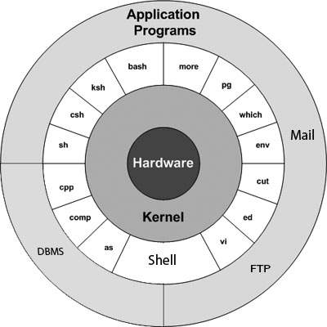
Unix Architecture:

Slide 55
The main concept that unites all the versions of Unix is the following four basics −
Kernel − The kernel is the heart of the operating system. It interacts with the hardware and most of the tasks like memory management, task scheduling and file management.
Shell − The shell is the utility that processes your requests. When you type in a command at your terminal, the shell interprets the command and calls the program that you want. The shell uses standard syntax for all commands. C Shell, Bourne Shell and Korn Shell are the most famous shells which are available with most of the Unix variants.
Commands and Utilities − There are various commands and utilities which you can make use of in your day to day activities. cp, mv, cat and grep, etc. are few examples of commands and utilities. There are over 250 standard commands plus numerous others provided through 3rd party software. All the commands come along with various options.

Slide 56
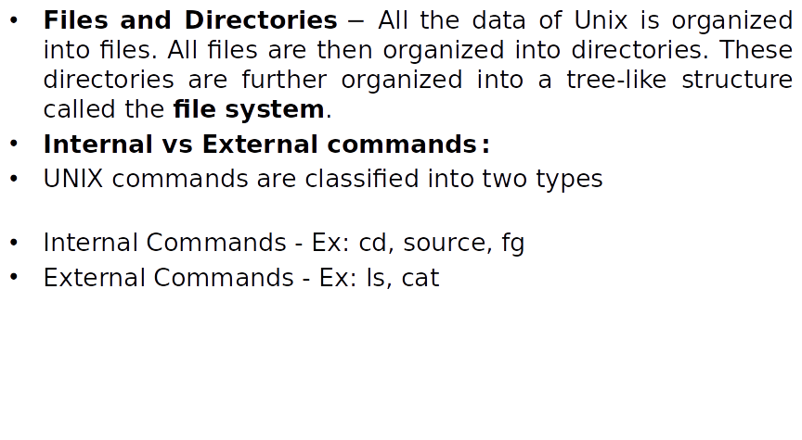

Slide 57
Internal & External commands :
Internal Command:
Internal commands are something which is built into the shell. For the shell built in commands, the execution speed is really high. It is because no process needs to be spawned for executing it. For example, when using the "cd" command, no process is created. The current directory simply gets changed on executing it.
echo isn’t an external command in the sense that, when you type echo, the shell won’t look in its PATH to locate it(even if it is there in /bin). Rather, it will execute it from its own set of built-in commands that are not stored as separate files. These built-in commands, of which echo is a member, are known as internal commands.

Slide 58
Getting the list of Internal Commands
If you are using bash shell you can get the list of shell built-in commands with help command :
$help
// this will list all
the shell built-in commands //

Slide 59
External Command:
External commands are not built into the shell. These are executables present in a separate file.
When an external command has to be executed, a new process has to be spawned and the command gets executed.
For example, when you execute the "cat" command, which usually is at /usr/bin, the executable /usr/bin/cat gets executed.
ls is a program or file having an independent existence in the /bin directory(or /usr/bin), it is branded as an external command that actually means that the ls command is not built into the shell and these are executables present in a separate file.
In simple words, when you will key in the ls command, to be executed it will be found in /bin.

Slide 60
echo command to display line of text/string that are passed as an argument . This is a built in command used in shell scripts and batch files to output status text to the screen or a file.
Syntax : echo [option] [string] Displaying a text/string :
Syntax : echo [string]
Options of echo command
NOTE :- -e here enables the interpretation of backslash escapes
1. \b : it removes all the spaces in between the text
2. \c : suppress trailing new line with backspace interpretor ‘-e‘ to continue without emitting new line.
In output, text after \c is not printed and omitted trailing new line. With every UNIX release, new tools are being added and the older ones are modified/ removed.
3. \n : this option creates new line from where it is used.
4. \t : this option is used to create horizontal tab spaces.
5. echo * : this command will print all files/folders, similar to ls command .
Ex : echo *

